Slide 1
RVEA

Slide 2
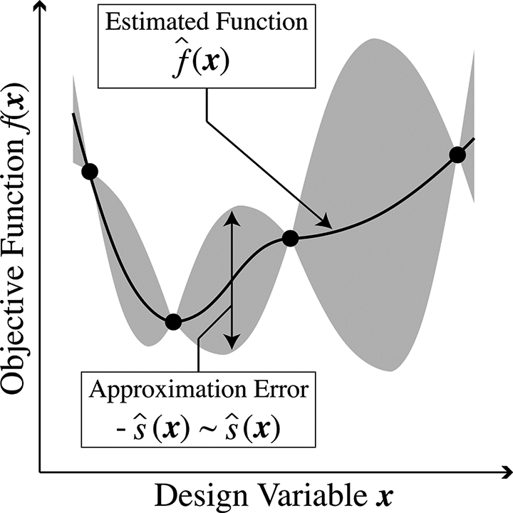
MOPs and Surrogate Modelling
Problems involving several conflicting objective functions are called multi-objective optimization problems.
Because of the conflict, there typically does not exist a single solution but multiple so-called Pareto optimal solutions.
In industrial optimization problems, computationally expensive functions are common.
Such problems can be handled using surrogates, which are approximate functions that replace the computationally expensive ones.
Evolutionary Algorithms can be used to find the pareto optimal solutions from these surrogates, which can then be used as is, or for further analysis.

Slide 3
Reference Vector Guided Evolutionary Algorithm vs MOEAs
Most conventional MOEAs fail to solve Many Objective Problems(MaOPs).
This can be attributed to loss of selection pressure when dominance is adopted as a selection criteria for individuals in a small population in high dimensionality problems.
RVEA handles MaOPs by using Reference vectors to guide the evolution towards the pareto front.

Slide 4

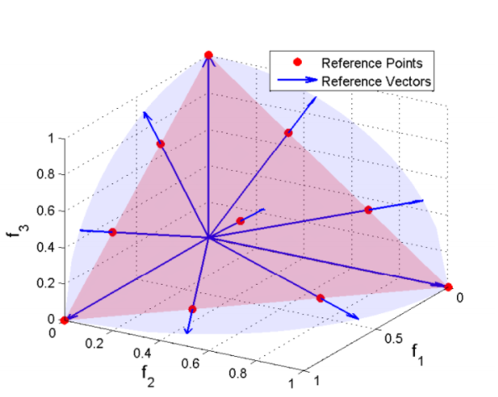
Reference vector

Slide 5
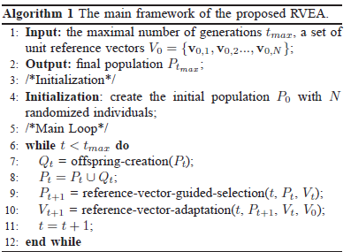
Basic algorithm

Slide 6
Off-spring creation
Simulated Binary Crossover
Polynomial Mutation

Slide 7
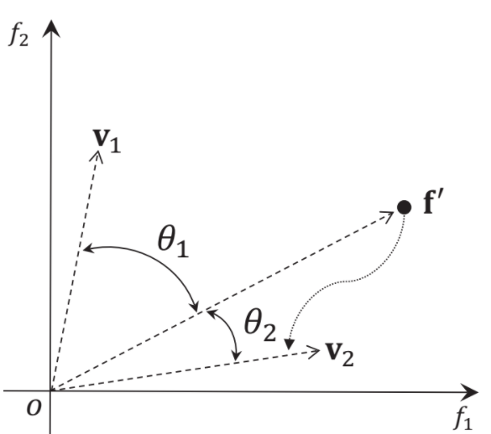
Reference Vector Guided Selection
Objective value translation:
Population partition:

Slide 8


Angle Penalized Distance:
Elitism selection..

Slide 9
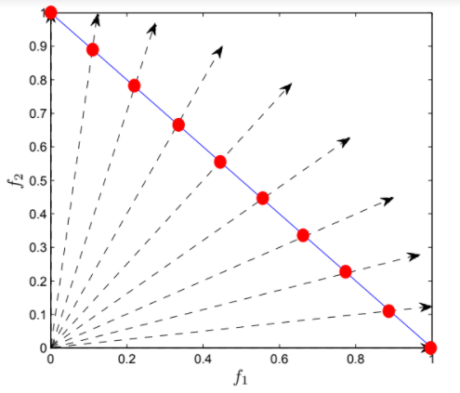
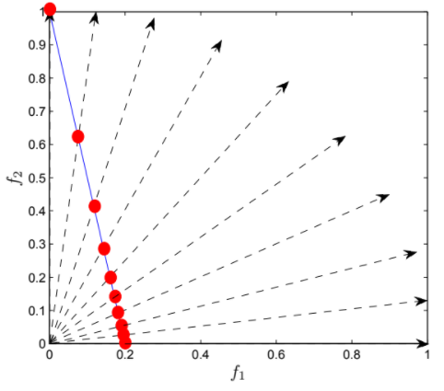
Reference vector adaptation

Slide 10
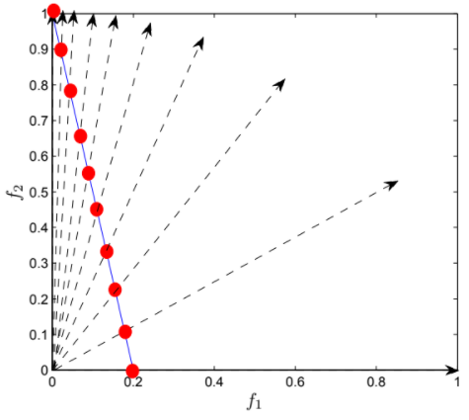


Slide 11
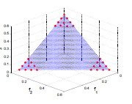

Preference Articulation

Slide 12
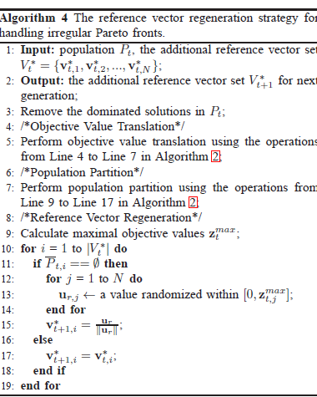
Irregular PFs

Slide 13
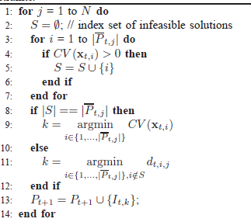

Handling constraints

Slide 14
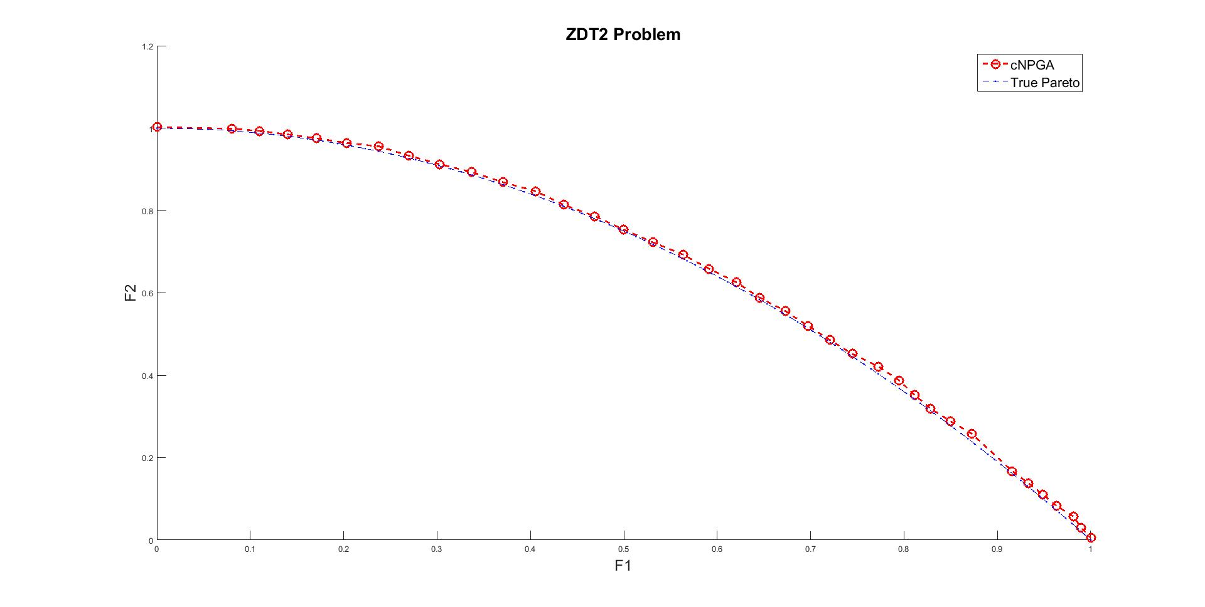
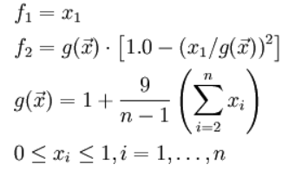
cRVEA
True Pareto

Slide 15
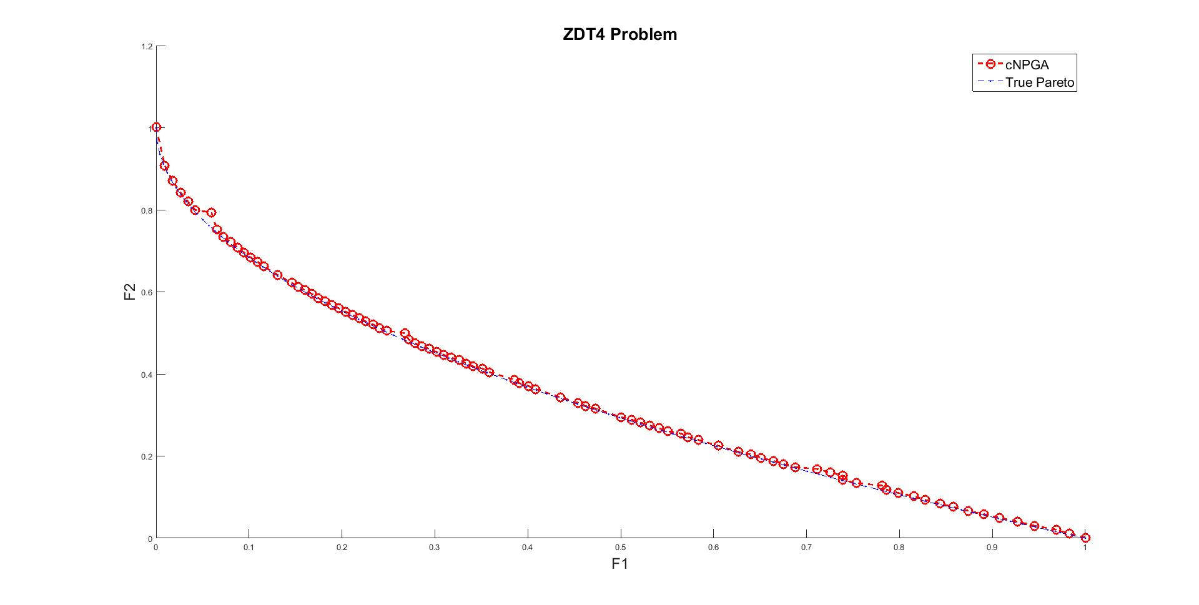
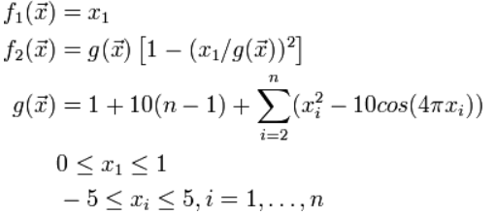
cRVEA
True Pareto

Slide 16
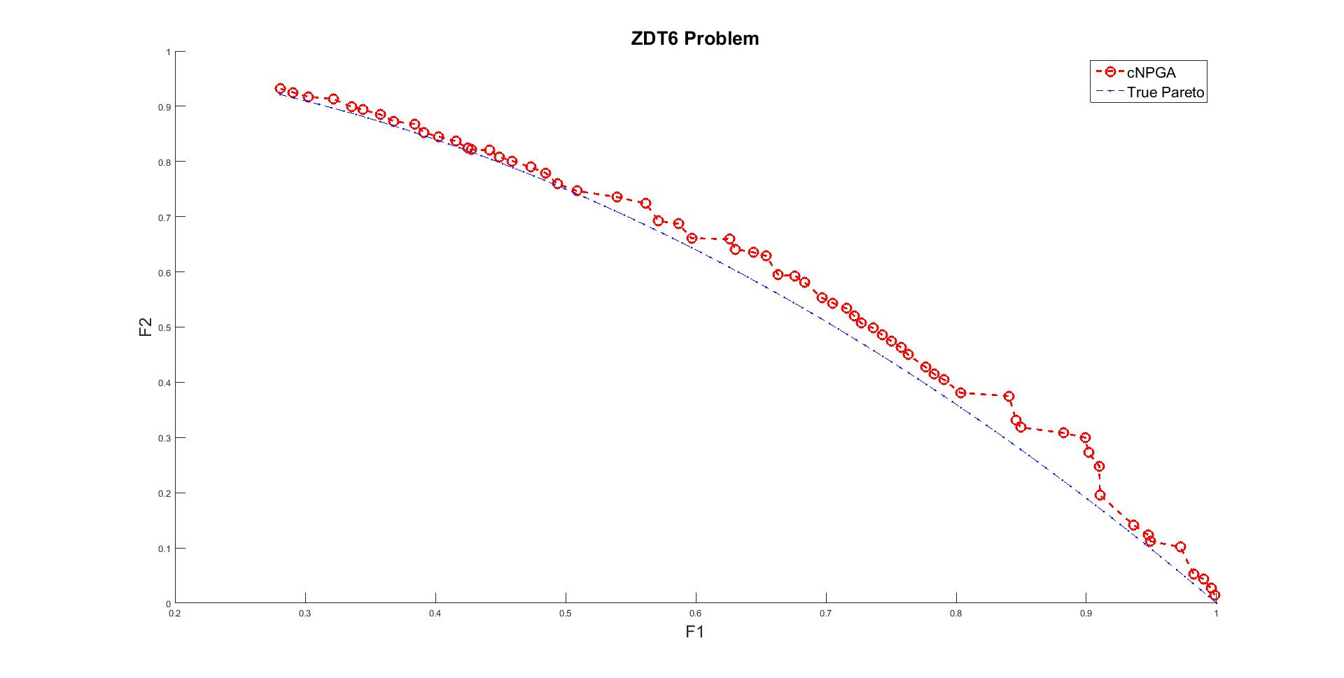
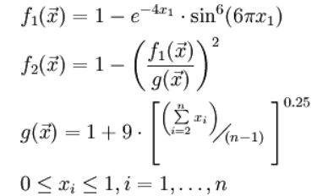
cRVEA
True Pareto

Slide 17
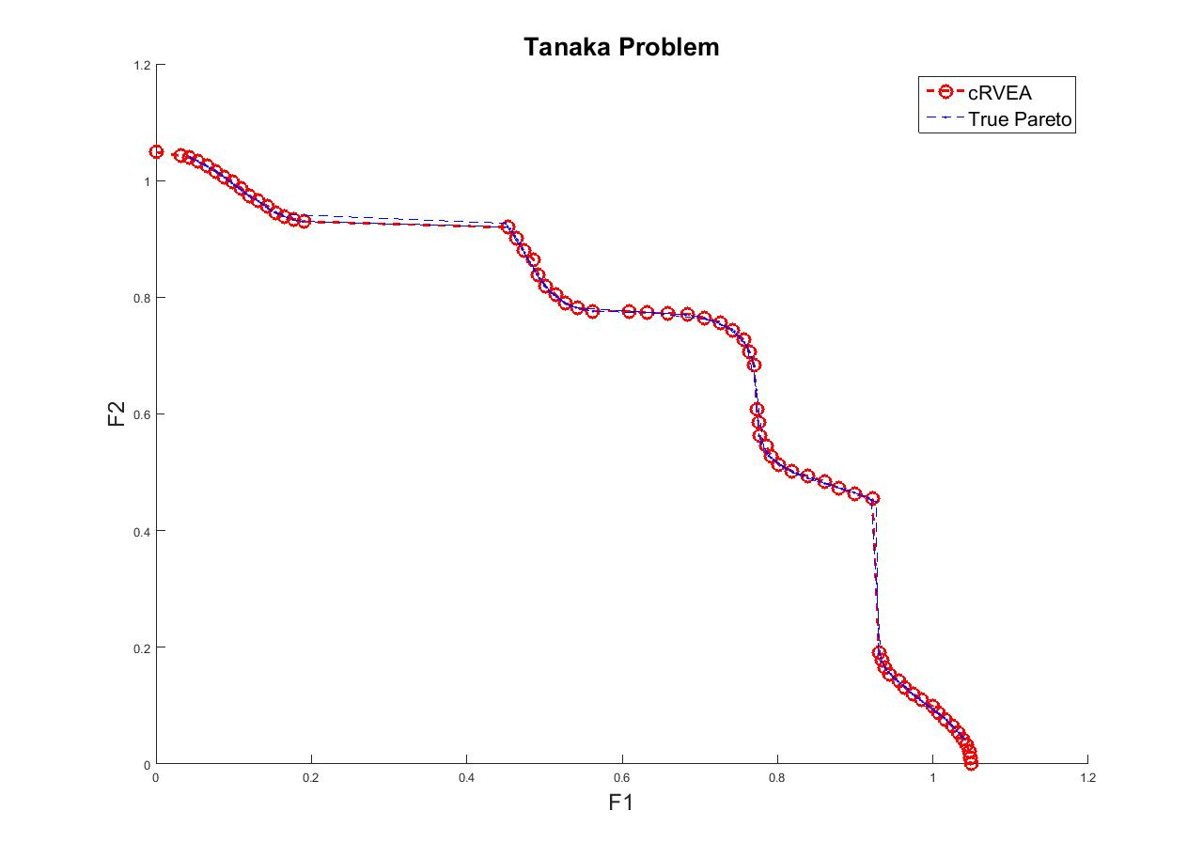

Slide 18
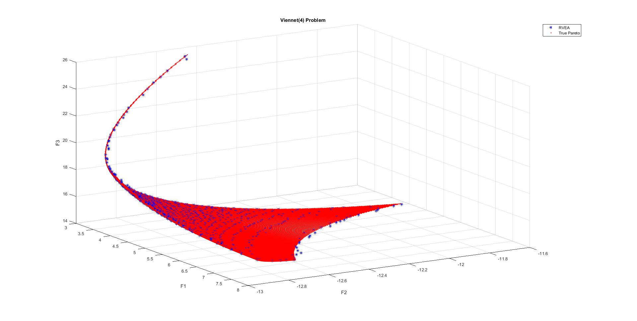

Slide 19
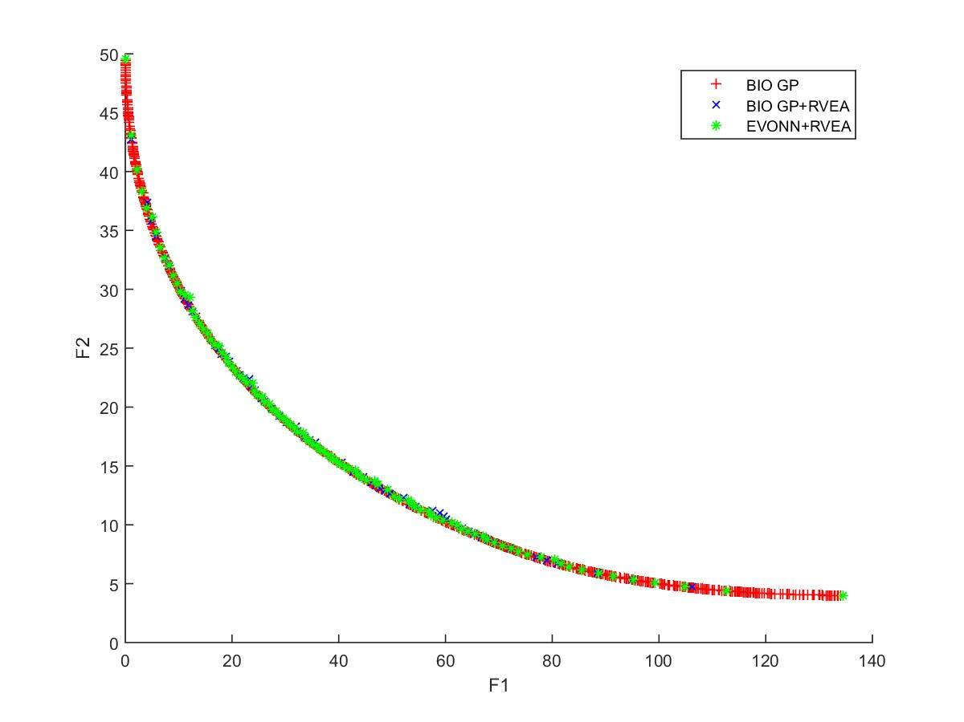

Slide 20
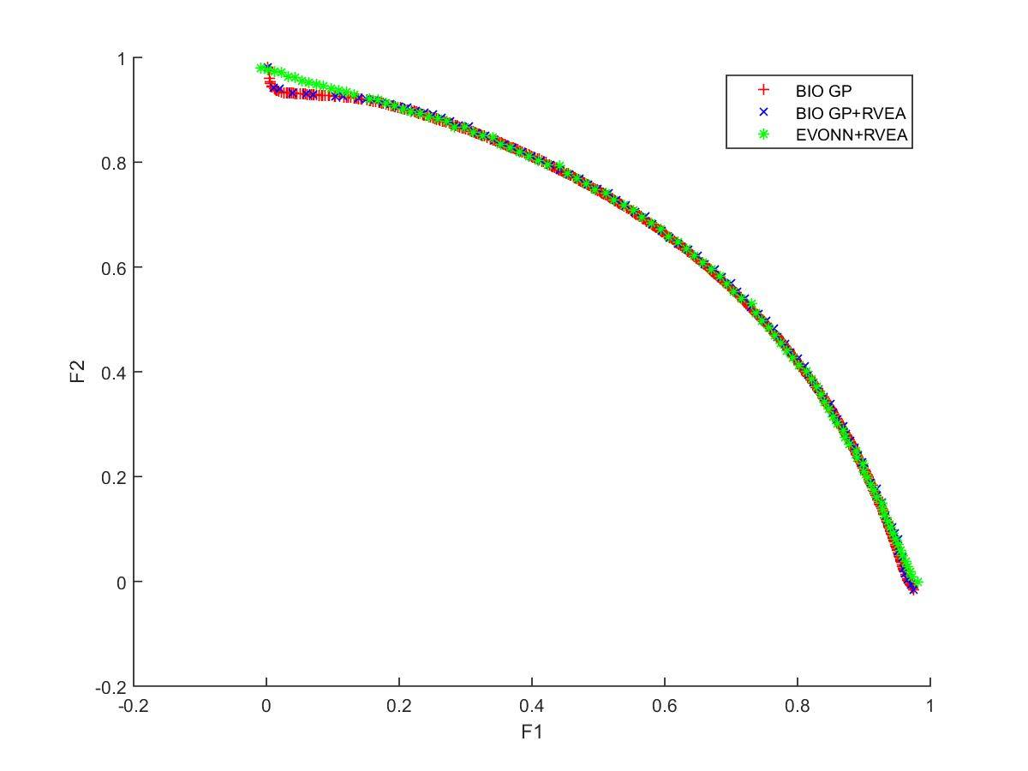

Slide 21
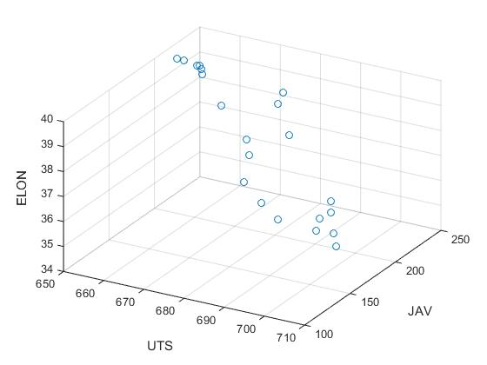

Slide 22
References
Cheng, R.; Jin, Y.; Olhofer, M.; Sendhoff, B. A Reference Vector Guided Evolutionary Algorithm for Many-Objective Optimization. IEEE Trans. Evol. Comput. 2016, 20 (5), 773–791.
Chugh, T.; Chakraborti, N.; Sindhya, K.; Jin, Y. A Data-Driven Surrogate-Assisted Evolutionary Algorithm Applied to a Many-Objective Blast Furnace Optimization Problem. Mater. Manuf. Process. 2017, 32 (10), 1172–1178.

